Slide 1
Project Title: Arduino Air Quality Monitor
Team Leader: Ritesh Pathak (22EE10053)
Team Members: *Charan Tej (22CH30010)
*Pritam Pal (22CH10049)
*Swadhin Biswal (22AG10046)

Slide 2
Background and Motivation
Our project idea was concerned about the rising pollution level in various cities.
It is essentially an inexpensive subordinate of air quality index (AQI), which is capable of determining local changes.
We also recognised the fact that temperature as well as humidity was an inseparable part of the air analysis, which directly or indirectly affects our day-to-day life.

Slide 3
Objectives
To analyse the quality of air surrounding the monitor, and display a message like “good”,”poor”, etc. with the aid of MQ-135 air quality sensor.
The sensor detects gases like ammonia, CO2, benzene, smoke …, and measures their concentration in ppm. It’s working consists of a sensitive component SnO2 whose conductivity defers in the presence of these gases.
It will also measure the temperature and humidity with the help of DHT11 Temperature and humidity sensor.

Slide 4
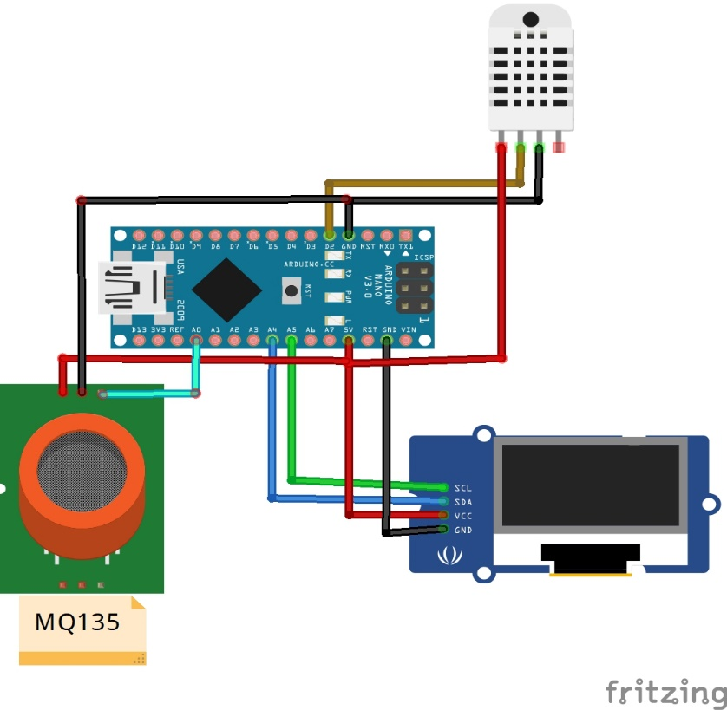
Schematic of setup
DHT 11 Sensor
Arduino Nano V3
0.96’ I2C OLED Display
MQ135 Sensor
Rough Schematic

Slide 5
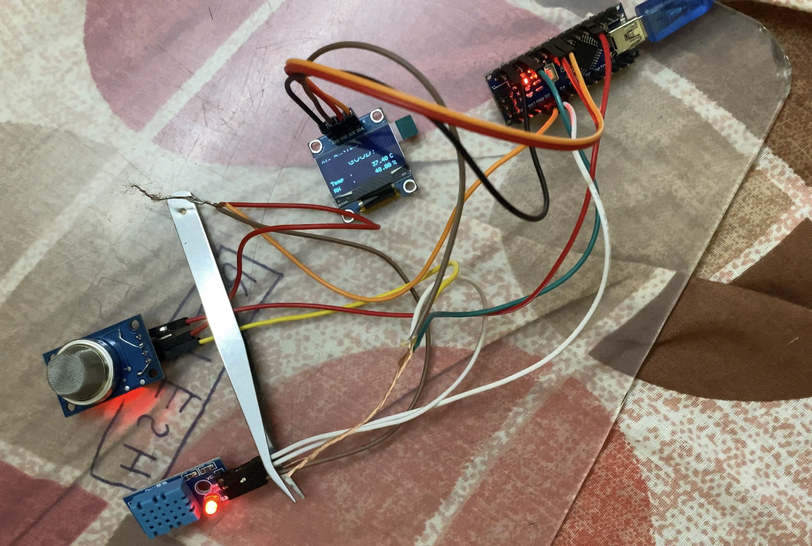
Connections
-> Connections from MQ135 Sensor:
# A0 to A0 of Arduino
#GND to GND of Arduino (**)
#VCC to 5V of Arduino (*)
-> Connections from DHT11 Sensor:
#GND to GND of Arduino (**)
#VCC to 5V of Arduino (*)
#DAT to D2 of Arduino
-> Connections from 0.96’ I2C OLED :
#SDA to A4 of Arduino
#SCK to A5 of Arduino
#VDD to 5V of Arduino (*)
#GND to GND of Arduino
NOTE : Connections with (*) and (**) indicate common soldered / joined ends , for respective combination.

Slide 6
Components and Working
The components used in this project are:
Arduino Nano V3 with USB Cable
MQ-135 Air quality sensor: Measures ppm concentration of gases like NH3, Sulfur, Benzene, CO2 and smoke . The electricity flowing in it ionizes the gases in contact, and then measures the change in conductivity. It then converts the value as signal and sends to arduino, which then compares it with predefined range of values and sends an output message.
DHT11 temperature and humidity sensor: It internally uses a thermistor and a capacitive humidity sensor (which measures the change in capacitance value due to the absorption of moisture by the dielectric material present in between).
0.96” i2c OLED Display screen: which displays all the output in digital form.

Slide 7
Coding section of the project
The project incorporates library codes through following libraries:
Adafruit_SSD1306.h
Adafruit_GFX.h
DHT.h
*There will be two main functions in the code: sendSensor() and air_sensor().
In air_sensor() function , it reads the analog value of MQ135 sensor and stores in the variable gasLevel , and then compares the value with different predefined range values. Post comparison it stores the result in variable quality, and ultimately sends signal to oled display to print the result.
In sendSensor() function , it reads two floating point values from the DHT11 sensor and stores in the variables h and t , and using isnan() confirms the proper input format. It then sends signal to oled display to print the results (Temperature in unit of “C”, and humidity (RH) in “%”)

Slide 8
Code
#include <SPI.h>
#include <Wire.h>
#include <Adafruit_GFX.h>
#include <Adafruit_SSD1306.h>
#include <Fonts/FreeSans9pt7b.h>
#include <Fonts/FreeMonoOblique9pt7b.h>
#include <DHT.h>
#define SCREEN_WIDTH 128 // OLED display width, in pixels
#define SCREEN_HEIGHT 64 // OLED display height, in pixels
#define OLED_RESET 4 // Reset pin # (or -1 if sharing Arduino reset pin)
Adafruit_SSD1306 display(SCREEN_WIDTH, SCREEN_HEIGHT, &Wire, OLED_RESET);

Slide 9
#define sensor A0
#define DHTPIN 2 // Digital pin 2
#define DHTTYPE DHT11 // DHT 11
int gasLevel = 0; //int variable for gas level
String quality ="";
DHT dht(DHTPIN, DHTTYPE);
void sendSensor()
{
float h = dht.readHumidity();
float t = dht.readTemperature();
if (isnan(h) || isnan(t)) {
Serial.println("Failed to read from DHT sensor!");
return;
}

Slide 10
display.setTextColor(WHITE);
display.setTextSize(1);
display.setFont();
display.setCursor(0, 43);
display.println("Temp :");
display.setCursor(80, 43);
display.println(t);
display.setCursor(114, 43);
display.println("C");
display.setCursor(0, 56);
display.println("RH :");
display.setCursor(80, 56);
display.println(h);
display.setCursor(114, 56);
display.println("%");
}

Slide 11
void air_sensor()
{
gasLevel = analogRead(sensor);
if(gasLevel<181){
quality = " GOOD!";
}
else if (gasLevel >181 && gasLevel<225){
quality = " Poor!";
}
else if (gasLevel >225 && gasLevel<300){
quality = "Very bad!";
}
else if (gasLevel >300 && gasLevel<350){
quality = "ur dead!";
}
else{
quality = " Toxic";
}

Slide 12
display.setTextColor(WHITE);
display.setTextSize(1);
display.setCursor(1,5);
display.setFont();
display.println("Air Quality:");
display.setTextSize(1);
display.setCursor(20,23);
display.setFont(&FreeMonoOblique9pt7b);
display.println(quality);
}
void setup() {
Serial.begin(9600);
pinMode(sensor,INPUT);
dht.begin();
if(!display.begin(SSD1306_SWITCHCAPVCC, 0x3c)) { // Address 0x3D for 128x64
Serial.println(F("SSD1306 allocation failed"));
}

Slide 13
display.clearDisplay();
display.setTextColor(WHITE);
display.setTextSize(2);
display.setCursor(50, 0);
display.println("Air");
display.setTextSize(1);
display.setCursor(23, 20);
display.println("Quality monitor");
display.display();
delay(1200);
display.clearDisplay();

Slide 14
display.setTextSize(2);
display.setCursor(20, 20);
display.println("By Group 12");
display.display();
delay(1000);
display.clearDisplay();
}
void loop() {
display.clearDisplay();
air_sensor();
sendSensor();
display.display();
}

Slide 15
Challenges faced And Solutions Found
The arduino’s pins were not soldered, due to which connecting the jumper wires was difficult as the pins were loose.
#Solution: We soldered the pins with arduino.
Code was not getting uploaded initially , which was due to absence of supporting driver for arduino Nano. (rather that of arduino UNO was present)
#Solution: We installed the Driver required for the functioning of Arduino Nano.
Creation of a proper enclosure for the purpose of safety of the sensitive sensors and oled display posed a challenge.
#Solution: We created an enclosure using small cardboard box by cutting some holes and sticking the sensors.

Slide 16
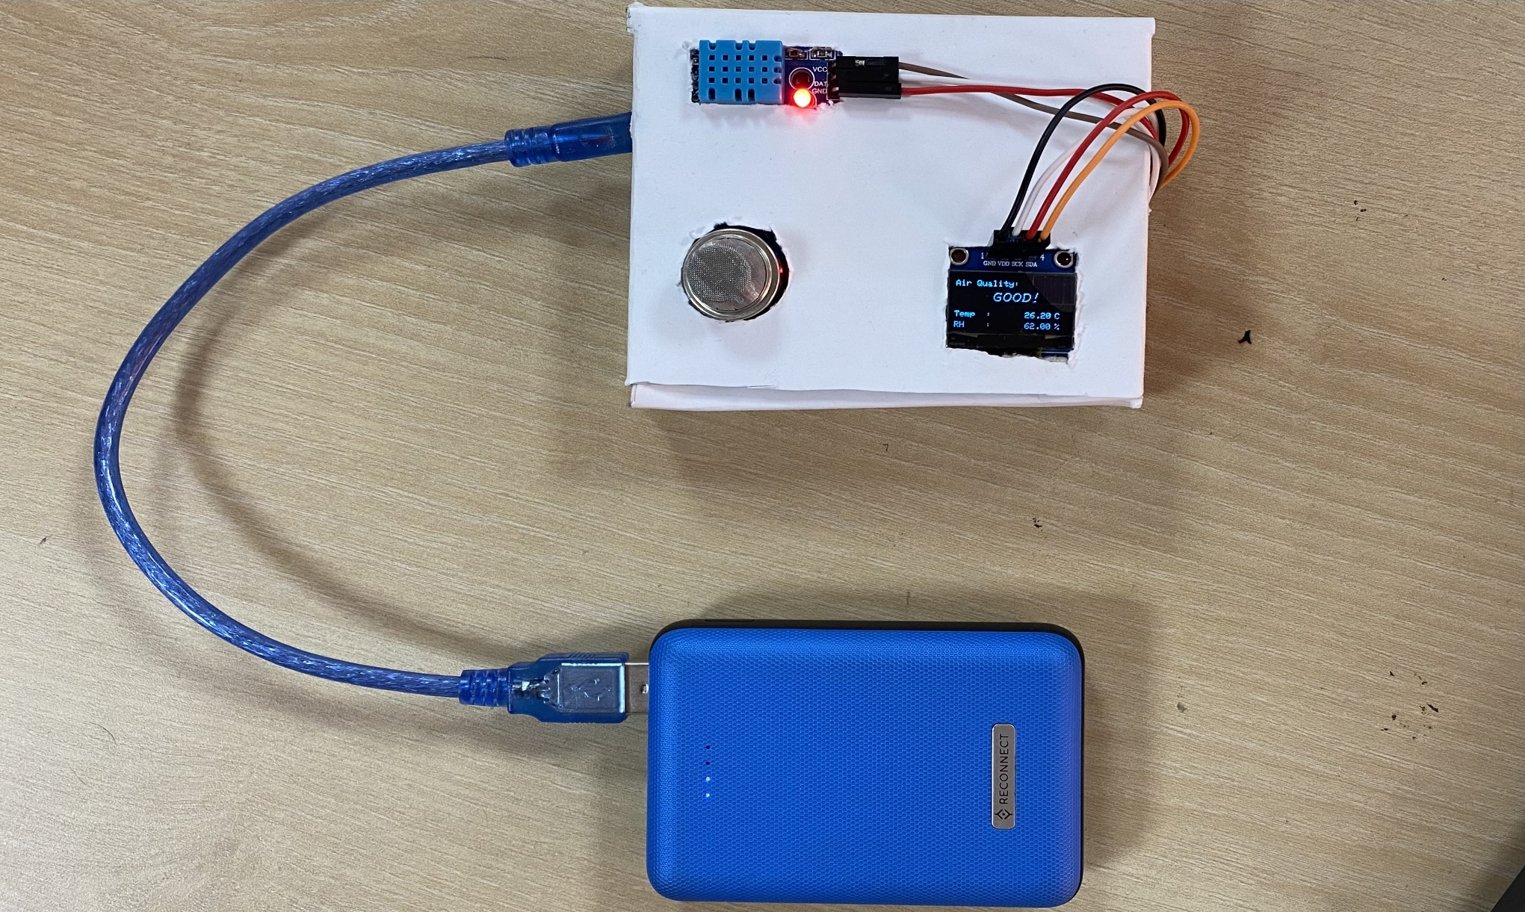
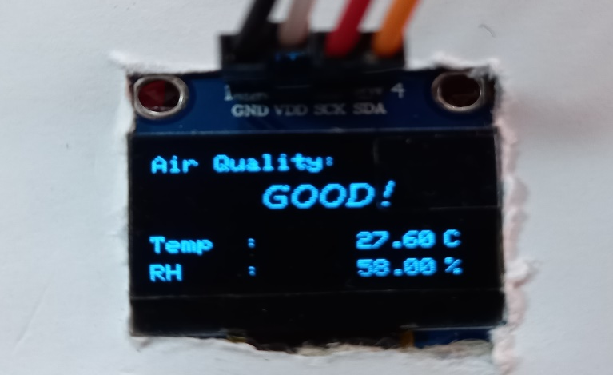
DIY Final Project visual in working State

Slide 17
Learnings from the Project
Understanding Air Quality: Through this project, we have gained knowledge about the concept of air quality and its importance. We realized through this project prolong use of goodnight card or jet in our rooms during nights can potentially affect the air quality of the concerned room.
Sensor Integration: We have learned how to integrate sensors into an Arduino based project. Specifically, we have used the MQ-135 sensor to measure air quality-related gases and the DHT11 sensor to measure temperature and humidity. This experience has given us the insights into connecting and working with sensors in real-world applications.
Display and Visualization: Integrating the OLED display into our project allowed us to showcase the air quality measurements in a user-friendly manner. We learned how to design and present the data on the display, enabling users to understand the air quality information at a glance.
Practical Application: Throughout the project, we gained hands-on experience in building a practical device that has real-world applications. We have explored how technology can be utilized to create tools that contribute to environmental monitoring, public health, and safety.

Slide 18
Individual Responsibilities
Swadhin:- Coding part
Pritam:- Wiring and Connections
Charan:- Making enclosure, Cura and Tinker cad
Ritesh:- Assigning work, presentation and assisting all members

Slide 19
Conclusions:
We created an arduino based model which aims to assess the quality of surrounding air as well as report the temperature and humidity.
The assessment tallies in good agreement with some performed cross checks which included burning paper (which prompted the oled to display “poor” ), as well as ambient air conditions resulted “good” in display.
The sensor calculated values of temperature and humidity (in “C” and “%” respectively) were reasonably close to the meteorological data for the concerned city.

Slide 20
References
https://projecthub.arduino.cc/abid_hossain/air-quality-monitor-14f9b4
https://www.youtube.com/watch?v=obNeqesglgQ
https://github.com/maaz-siddiqui/ESP32_MQ-135_SH1106

Slide 21
THANK YOU

